Slide 1
Connecting and cognifying nearly every thing, place, and service
Jorge Fonseca (he/him)
Senior Solutions Architect
Amazon Web Services
Notes:
Welcome to the AWS Unlocking the potential of IoT in Travel and Hospitality Session. I’m SriHari Thotapalli, Principal Solutions Architect for AWS Travel & Hospitality. We are grateful that you’re able to join us today.
Abstract: Travel and hospitality companies looking to meet customer expectations and differentiate themselves from their competitors are turning to the Internet of Things (IoT). In this session, you will learn how early adopters are using IoT to develop connected kitchen and hotel room experiences, implement airline bag tracking solutions and aircraft turn tracking solutions, and more. Discover how you can take advantage of the latest IoT advancements to improve your business outcomes.

Slide 2

The book
2016
3 decades since the birth of the internet
tech forces that will shape the next 30 years

Slide 3
The forces
Cognifying
• Becoming
• Interacting
• Filtering
Screening
• Questioning
• Remixing
• Flowing
Sharing
• Tracking
• Accessing
• Beginning

Slide 4



Agenda
Cognifying
Screening
Sharing
Why?
How?
Where?

Slide 5

Cognifying
• Becoming
• Interacting
• Filtering
Screening
• Questioning
• Remixing
• Flowing
Sharing
• Tracking
• Accessing
• Beginning
Cognifying
A.I. will cognify objects, making them intelligent
✅ smart things: lights, thermostats
⚠️ most home appliances still dumb

Slide 6

Cognifying
• Becoming
• Interacting
• Filtering
Screening
• Questioning
• Remixing
• Flowing
Sharing
• Tracking
• Accessing
• Beginning
Becoming
All things will upgrade via internet
✅ software, 5.6B internet users (64%), Starlink, Kuiper
⚠️ few things are connected (Wi-Fi, 2G/5G)

Slide 7

Cognifying
• Becoming
• Interacting
• Filtering
Screening
• Questioning
• Remixing
• Flowing
Sharing
• Tracking
• Accessing
• Beginning
Interacting
Anything not interactive will be considered broken
✅ tablets in cars dashboards, restaurants, stores
⚠️ children touch things in museums as if tablets

Slide 8

Cognifying
• Becoming
• Interacting
• Filtering
Screening
• Questioning
• Remixing
• Flowing
Sharing
• Tracking
• Accessing
• Beginning
Filtering
We’ll customize/personalize, anticipate experiences
✅ machine learning predictions: media, shopping
⚠️ average, not unique – guessing, not asking

Slide 9

Cognifying
• Becoming
• Interacting
• Filtering
Screening
• Questioning
• Remixing
• Flowing
Sharing
• Tracking
• Accessing
• Beginning
Screening
Screens will be in every object, adapting to users
✅ 6.8B smartphones, 86% of global population
⚠️ hard/costly to build UX in X-small UI

Slide 10
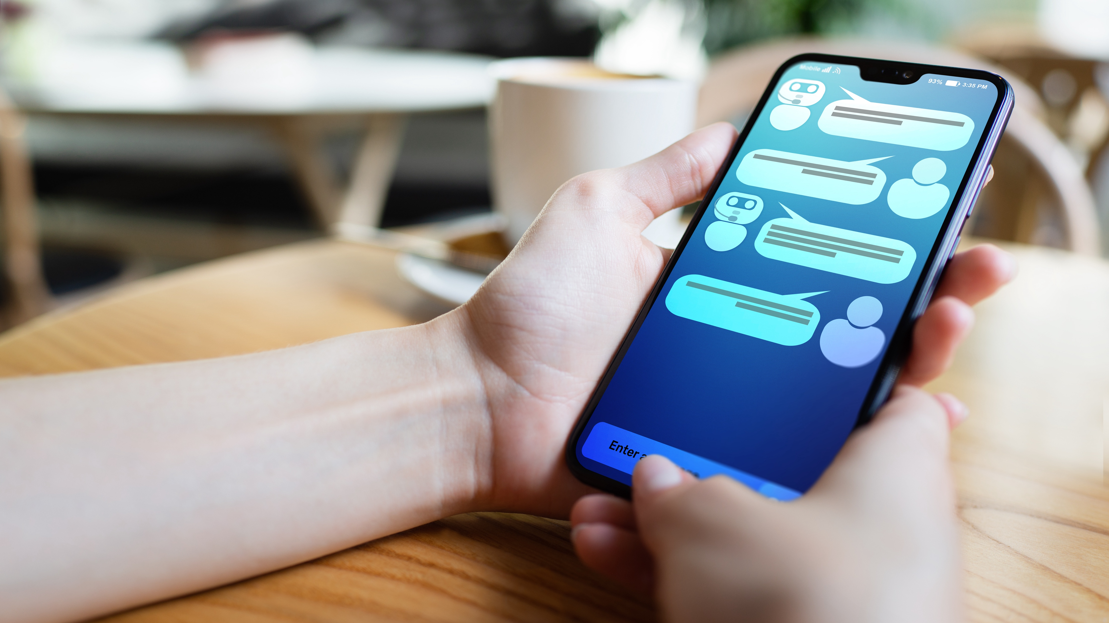
Cognifying
• Becoming
• Interacting
• Filtering
Screening
• Questioning
• Remixing
• Flowing
Sharing
• Tracking
• Accessing
• Beginning
Questioning
Good questions +valuable than good answers
✅ generative AI, search engines
⚠️ most UI interactions are fixed command buttons

Slide 11

Cognifying
• Becoming
• Interacting
• Filtering
Screening
• Questioning
• Remixing
• Flowing
Sharing
• Tracking
• Accessing
• Beginning
Remixing
We’ll combine primitive parts into new data flows
✅ app OS, cloud building blocks
⚠️ tax return forms, service registration/onboarding

Slide 12

Cognifying
• Becoming
• Interacting
• Filtering
Screening
• Questioning
• Remixing
• Flowing
Sharing
• Tracking
• Accessing
• Beginning
Flowing
We’ll depend on unstoppable streams
✅ social networks, streaming, real-time banking
⚠️ ad revenue driven, spam, right to be forgotten

Slide 13

Cognifying
• Becoming
• Interacting
• Filtering
Screening
• Questioning
• Remixing
• Flowing
Sharing
• Tracking
• Accessing
• Beginning
Sharing
We’ll share everything
✅ social, work, videos, tap to pay
⚠️ covid certificates

Slide 14

Cognifying
• Becoming
• Interacting
• Filtering
Screening
• Questioning
• Remixing
• Flowing
Sharing
• Tracking
• Accessing
• Beginning
Tracking
Every activity will be recorded, for user’s benefit
✅ fit band, navigation apps, loyalty cards, city cameras
⚠️ data silos

Slide 15

Cognifying
• Becoming
• Interacting
• Filtering
Screening
• Questioning
• Remixing
• Flowing
Sharing
• Tracking
• Accessing
• Beginning
Accessing
We’ll use when needed, instead of owning
✅ video/music streaming, cloud compute
⚠️ drivers’ identity fraud, racial biases, religious choices

Slide 16

Cognifying
• Becoming
• Interacting
• Filtering
Screening
• Questioning
• Remixing
• Flowing
Sharing
• Tracking
• Accessing
• Beginning
Beginning
We’ll connect all humans and machines globally
✅ internet
⚠️ ambient computing, metaverse

Slide 17
About me

Slide 18
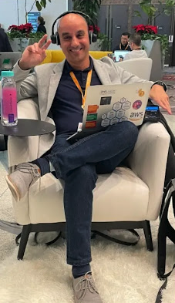

About me
Jorge Fonseca (he/him)
Senior Solutions Architect Amazon Web Services
linkedin.com/in/jorgefonseca

Slide 19
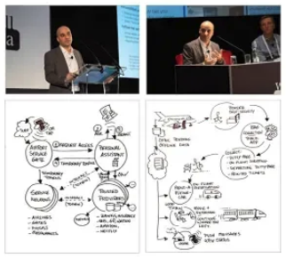
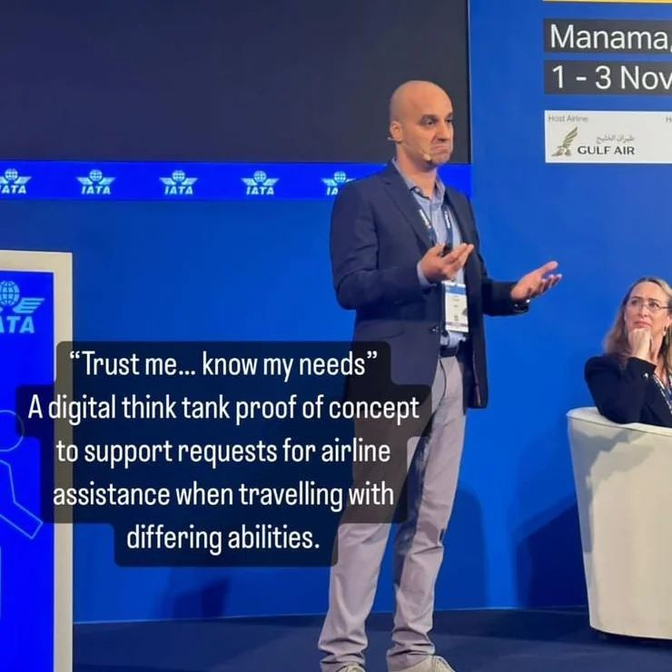
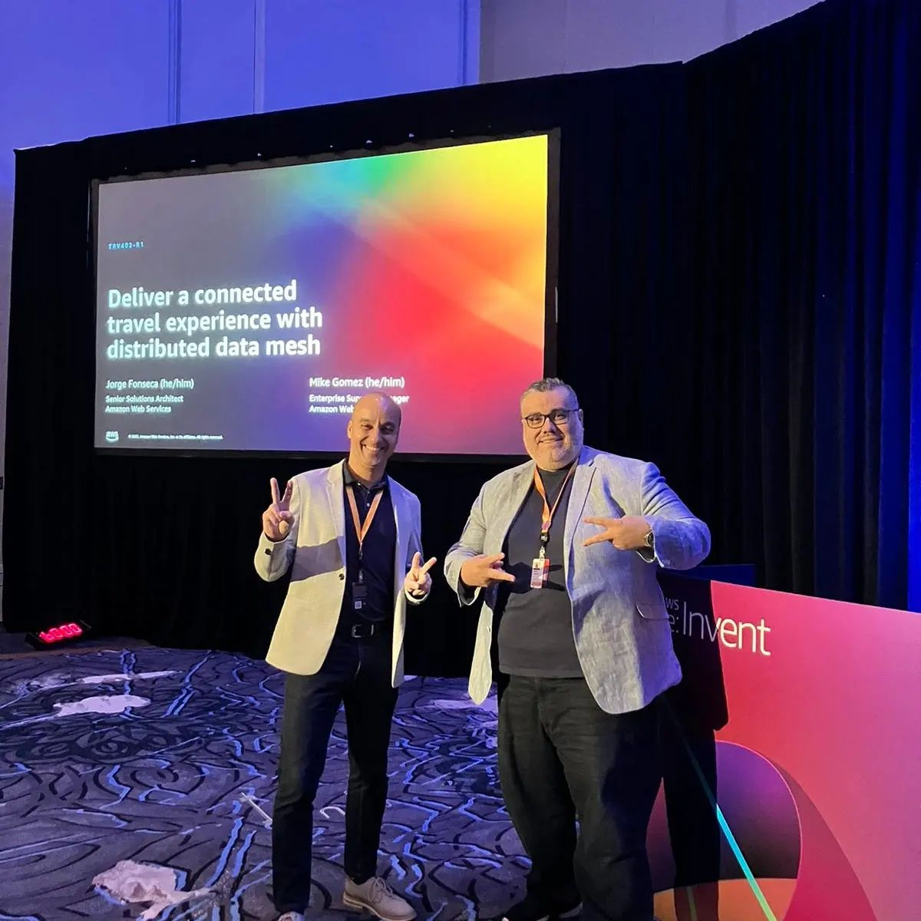
About the past
2018 @ London, UK Enterprise Cloud Comp. conf.
The future of customer experience in commercial aviation
2022 @ Manama, Bahrain World Passenger Symposium
IATA Digital Think Tank Trust me, know my needs W3C DIDs, VCs, DIDcomm
2022 @ Las Vegas, USA AWS re:Invent
Deliver a connected travel experience with distributed data mesh

Slide 20
About the future
Share with trust
Domain trust framework Decentralized backbone
Remix user screens
UI primitive parts Session dialogs
Cognify everything
One tap to connect One tap interactions

Slide 21
END OF PREVIEW
This was the first part of a 3-part presentation.
The second part covers the architectures that describe the framework, and the third part dives into the API definitions that will allow the audience to create new applications or adapt existing ones to integrate the ecosystem.

